Slide 1
Deep Visual-Semantic Alignments for Generating Image Descriptions
Summary

Slide 2
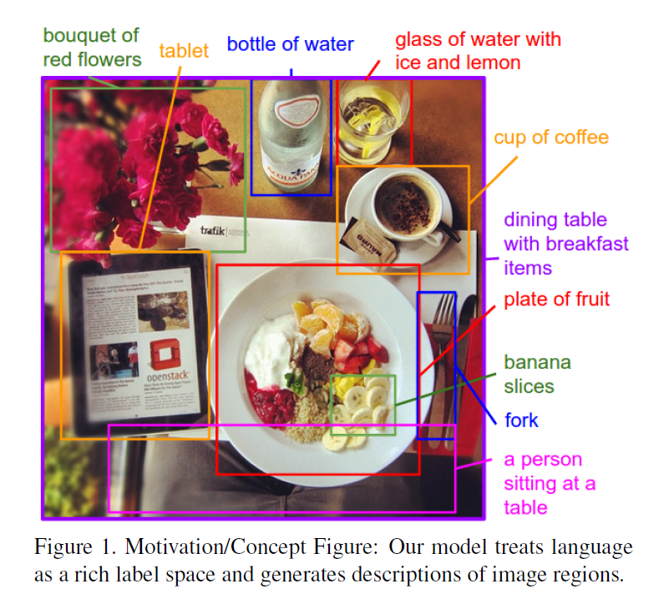
Motivation
Previous work in Visual Recognition focused on
Labeling images with fixed set of visual categories
Vastly restrictive when compared to rich descriptors humans compose
Hard coded visual concepts and sentence templates; Restricts variety
The goal of this paper is to generate dense description of images.
Free of assumptions about specific hard coded templates, rules or categories

Slide 3
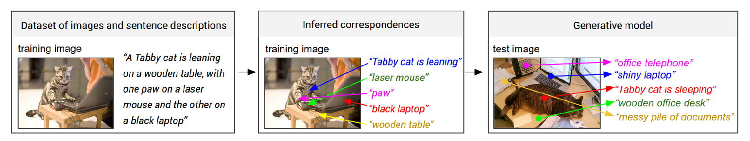
Contribution
Develop a Neural Network model that infers alignment between segments of sentences and the region of the image that they describe
Map words and image regions to a common, multimodal embedding
Multimodal Recurrent Neural Network architecture that takes an input image and generates its description in text

Slide 4
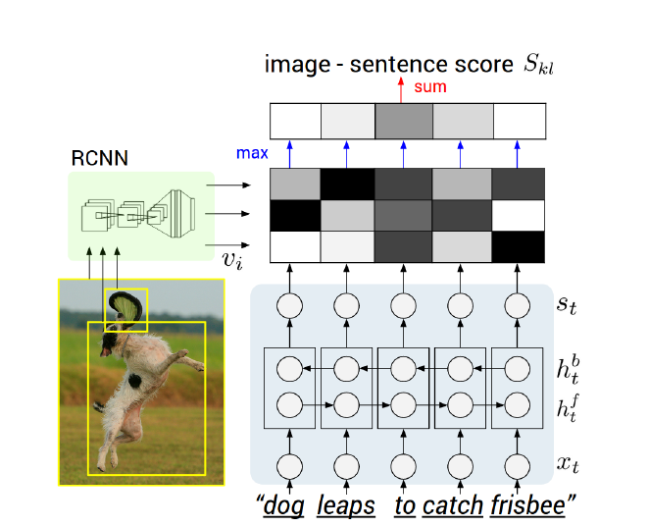
model
Diagram for evaluating the image-sentence score S_{kl}.
Object regions are embedded with a CNN (left).
Words (enriched by their context) are embedded in the same multimodal space with a BRNN (right).
Pairwise similarities are computed with inner products (magnitudes shown in grayscale) and finally reduced to image-sentence score

Slide 5
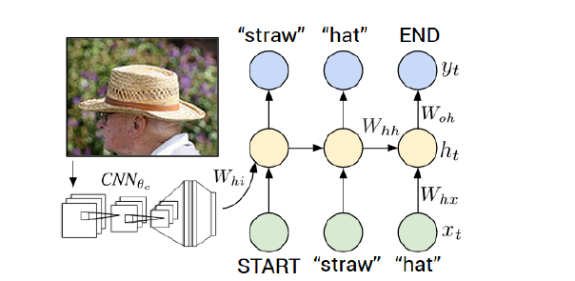
model
Diagram of multimodal Recurrent Neural Network generative model.
The RNN takes a word, the context from previous time steps and defines a distribution over the next word in the sentence.
The RNN is conditioned on the image information at the first time step. START and END are special tokens.

Slide 6
experiments
Dataset used:
Flickr8K, Flickr30K, MSCOCO
Each annotated with 5 sentences using Amazon Mechanical Turk
Data Preprocessing
convert all sentences to lowercase
discard non-alphanumeric characters
filter words to those that occur at least 5 times in the training set

Slide 7
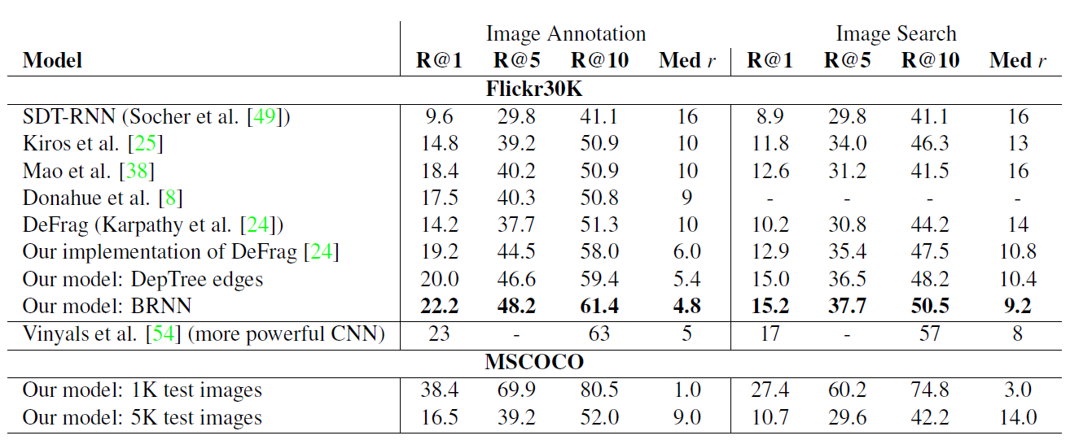
Results
Image –Sentence Alignment Evaluation
From a withheld set of images and sentences we retrieve items in one modality given a query from the other by sorting base on the image-sentence score S_{kl}
Parameters used for comparing
Median rank of the closest ground truth result in list
Recall @ K, ie Fraction of times a correct item was found among top K results.
Notes:
Table 1. Image-Sentence ranking experiment results. R@K is Recall@K (high is good). Med r is the median rank (low is good). In the
results for our models, we take the top 5 validation set models, evaluate each independently on the test set and then report the average
performance. The standard deviations on the recall values range from approximately 0.5 to 1.0.

Slide 8
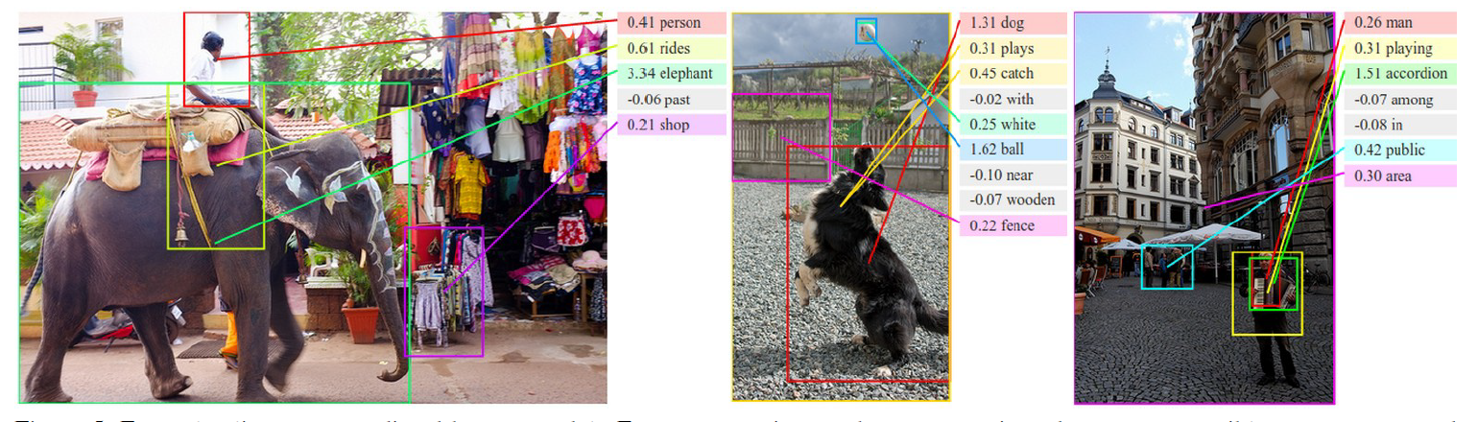
results

Slide 9
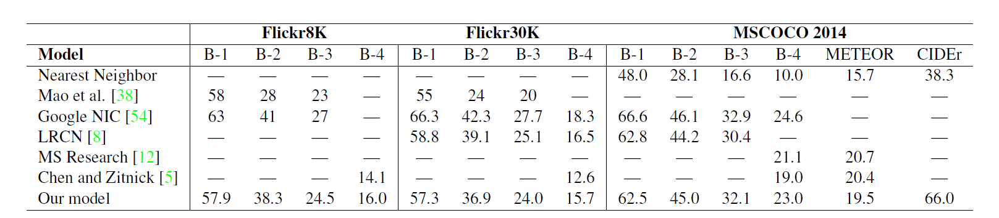
results
General Descriptions: Fullframe Evaluation
Trained Multimodal RNN to generate sentences on full images with the goal of verifying that the image description is rich enough.
Baseline used : Nearest neighbor retrieval baseline. Each test image annotated with a sentence of the most similar training set image as determined by L2 norm over VGGNet FC7 features.

Slide 10
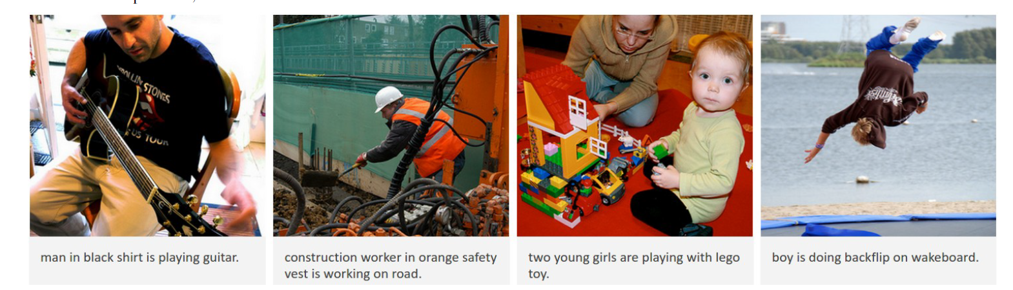
results

Slide 11
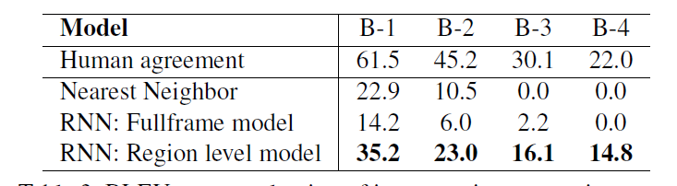
results
Generated Descriptions: Region Evaluation
We now train the Multimodal RNN on the correspondences between image regions and snippets of text, as inferred by the alignment model.
To support the evaluation, Amazon Mechanical Turk used to collect a new dataset used at test time.

Slide 12
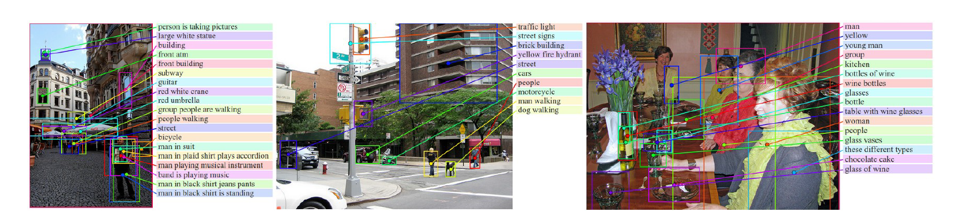
results

Slide 13
Limitations / future work
Model can only generate description of one input array of pixels at fixed resolution.
Use multiple saccades around the image to identify all entities, their mutual interactions and wider context before generating description.
RNN receives image information only through additive bias interaction.
This approach consists of two separate models.

Slide 14
Things to understand
BRNN
Specialized CNN (VGGNet, GoogLE Net, Alexnet etc.)
(Markov Random Fields) MRF
DeepTree Edges, Dependency tree relations
Beam Search

